Slide 1
Android Styles and Themes

Slide 2
What is Style and Themes
Styles and Themes are used to change the look and feel of Views and appearance of application based on our requirements. By using Styles and Themes we can reduce the code duplication and make our app light & responsive.
Generally, the style is a combination of multiple attributes such as background color, font color, font size, font style, height, width, padding, margin, etc. and it is used to change the look and feel of View or window.
In android, the style is defined in a separate XML resource file and we can use that defined style for the Views in XML that specifies the layout. The Styles in android are similar to CSS styles in web design.

Slide 3
Example
<TextView android:id="@+id/txtResult" android:layout_width="wrap_content" android:layout_height="wrap_content" android:textColor="#86AD33" android:textSize="20dp" android:textStyle="bold" />
Suppose if we use same or similar TextView styles in multiple places of our application, then the duplication of code will increase and in future, if we want to change the style of our application, we need to update the same style in all the places and it’s a time-consuming process.
We can overcome this problem by defining a style for the particular view and use the same style in all the places wherever it is required in our application.

Slide 4
Theme
Theme is a style that is applied to an entire activity or app, instead of an individual View like as mentioned above. When we applied a style as a theme, the views in activity or app apply to the all style attributes that supports. For example. If we apply TextviewStyle as a theme for an activity, then the text of all the views in activity appears in the same style.
In simple words, if we use an entry from a resource file to style a view, then we can call it a style. In case if we use an entry from a resource file to style activity or app, then we can call it a theme.

Slide 5
Android Defining Styles
We need to define a style in a separate XML resource file and use that defined style for the Views in XML that specifies the layout.
To define a set of styles, we need to create a new XML file in /res/values directory of our project and the root node of XML file must be a <resources>
<resources> <style name="TextviewStyle"> <item name="android:textColor">#86AD33</item> <item name="android:textStyle">bold</item> <item name="android:textSize">20dp</item> <item name="android:padding">10dp</item> </style> </resources>

Slide 6
Android Apply a Style to View
Once we are done with the creation of style, we can use it for the views which are defined in the XML layout file with style attribute.
Example of setting a style for the views in the XML layout.
<TextView android:id="@+id/txtResult" android:layout_width="wrap_content" android:layout_height="wrap_content" style="@style/TextviewStyle" android:text="Welcome to Tutlane"/>

Slide 7
Android Style Inheritance
In android, by using parent attribute in <style> element we can inherit the properties from an existing style and define only the attributes that we want to change or add. We can inherit the styles that we created ourselves or from the styles that are built into the platform.
Following is the example to inherit the android platform’s default TextView style (@android:style/Widget.TextView) and modify it.
<style name="TextviewStyle" parent="@android:style/Widget.TextView"> <item name="android:textColor">#86AD33</item> <item name="android:textStyle">bold</item> <item name="android:textSize">20dp</item> </style>
If you observe above code snippet, we are inheriting built-in platform style Widget.TextView using parent attribute in <style> element.

Slide 8
Inherit Self Defined Style
In android, we can inherit the styles that we defined our self. To inherit our styles we don’t need to use parent attribute instead, we can use dot notation by prefixing the name of the style that we want to inherit to the name of our new style, separated by a period.
Example
<style name="TextviewStyle" parent="@android:style/Widget.TextView"> <item name="android:layout_width">wrap_content</item> <item name="android:layout_height">wrap_content</item> <item name="android:textColor">#86AD33</item> <item name="android:textStyle">bold</item> <item name="android:textSize">20dp</item> <item name="android:layout_marginTop">12dp</item> <item name="android:layout_marginLeft">100dp</item> </style>

Slide 9
Example
<style name="TextviewStyle" parent="@android:style/Widget.TextView"> <item name="android:layout_width">wrap_content</item> <item name="android:layout_height">wrap_content</item> <item name="android:textColor">#86AD33</item> <item name="android:textStyle">bold</item> <item name="android:textSize">20dp</item> <item name="android:layout_marginTop">12dp</item> <item name="android:layout_marginLeft">100dp</item> </style> <style name="TextviewStyle.Blue"> <item name="android:textColor">#0088CC</item> <item name="android:textStyle">italic</item> </style> <style name="TextviewStyle.Blue.Background"> <item name="android:background">#FBBC09</item> </style>

Slide 10
Android Defining Themes
Theme is a style that is applied to an entire activity or app, instead of an individual View like as mentioned above. When we applied a style as a theme, the views in activity or app apply to the all style attributes that supports. For example. If we apply TextviewStyle as a theme for an activity, then the text of all the views in activity appears in the same style.
<color name="custom_theme_color">#b0b0ff</color> <style name="CustomTheme" parent="Theme.AppCompat.Light"> <item name="android:windowBackground">@color/custom_theme_color</item> <item name="android:colorBackground">@color/custom_theme_color</item> </style>
The above code overrides windowBackground and colorBackground properties of Theme.AppCompat.Light theme.

Slide 11
Set theme for a particular Activity or All Activities
To set a theme for a particular activity, open AndroidManifest.xml file and write the code.
<activity android:theme="@android:style/CustomTheme">
Set the theme for all the activities in android application
<application android:theme="@android:style/CustomTheme">

Slide 12
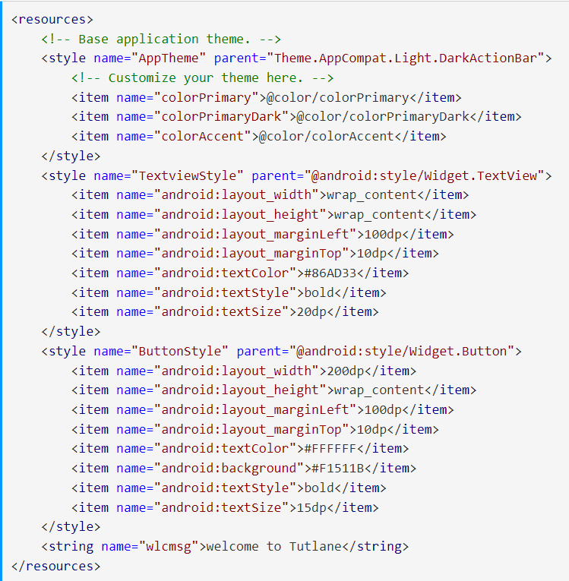
Example
Create style.xml inside res/values

Slide 13
activity_main.xml

